Slide 1
Sorting In Linear Time

Slide 2
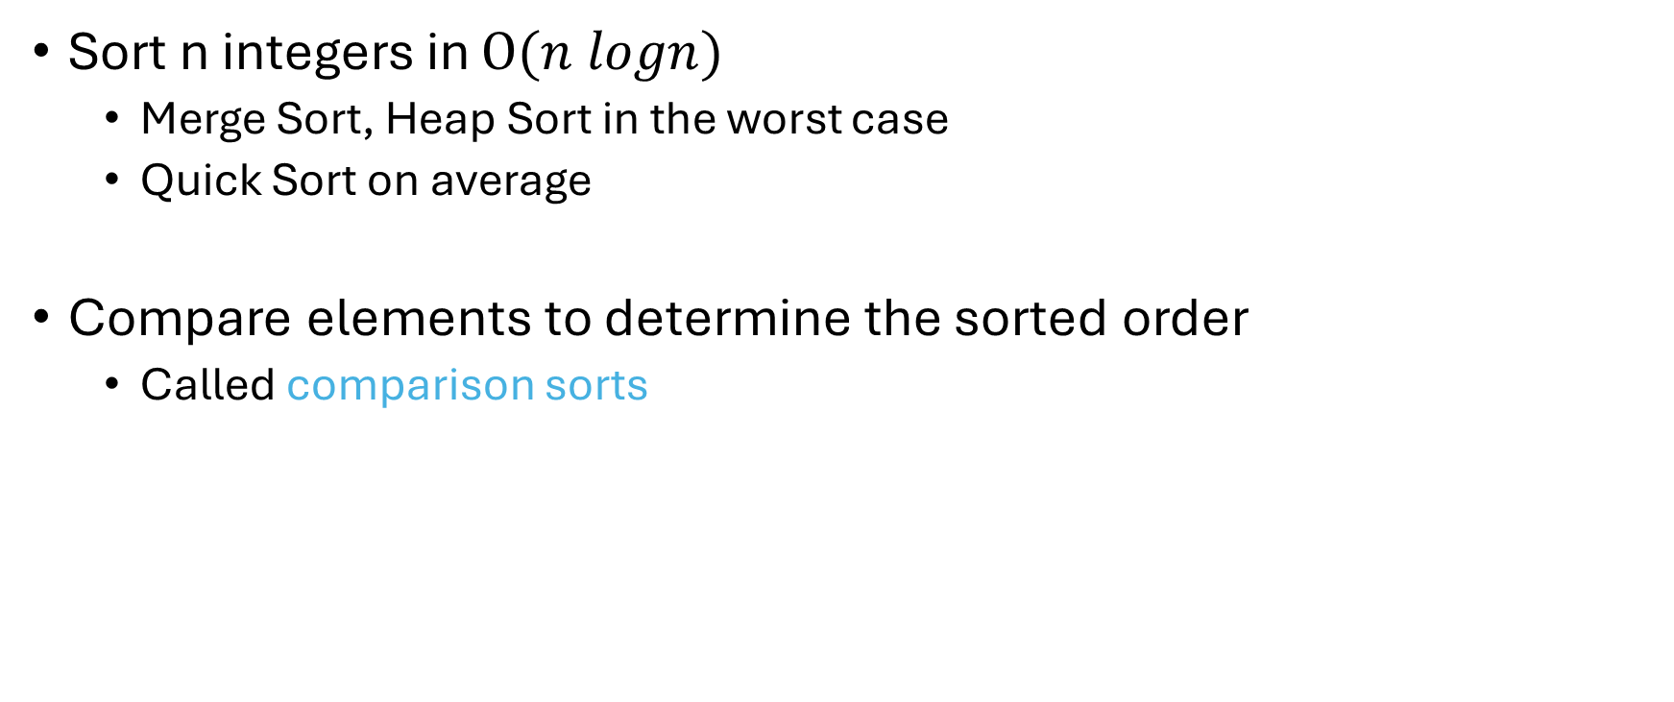
Sorting
Sort n integers in $Ο(n logn)$
Merge Sort, Heap Sort in the worst case
Quick Sort on average
Compare elements to determine the sorted order
Called comparison sorts

Slide 3
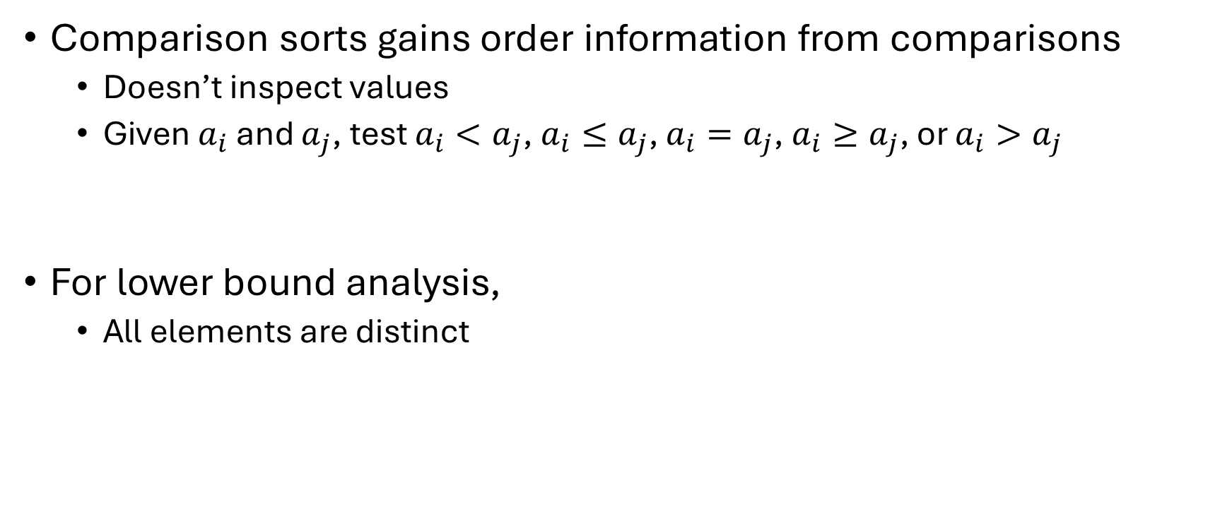
Lower Bounds for Sorting
Comparison sorts gains order information from comparisons
Doesn’t inspect values
Given $a_{i}$ and $a_{j}$, test $a_{i}<a_{j}$, $a_{i}≤a_{j}$, $a_{i}=a_{j}$, $a_{i}≥a_{j}$, or $a_{i}>a_{j}$
For lower bound analysis,
All elements are distinct

Slide 4
Lower Bounds for Sorting
The decision tree model
A full binary-tree
Node is either a leaf or has both children
Node represents the comparisons between two elements
a >=b
Yes
No
Do Something
Do Something Else

Slide 5
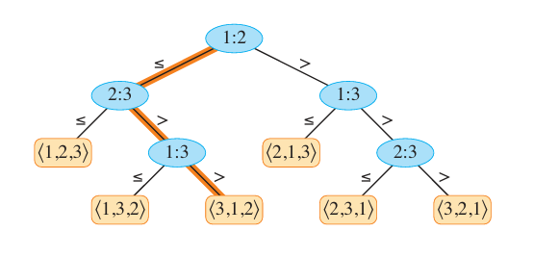
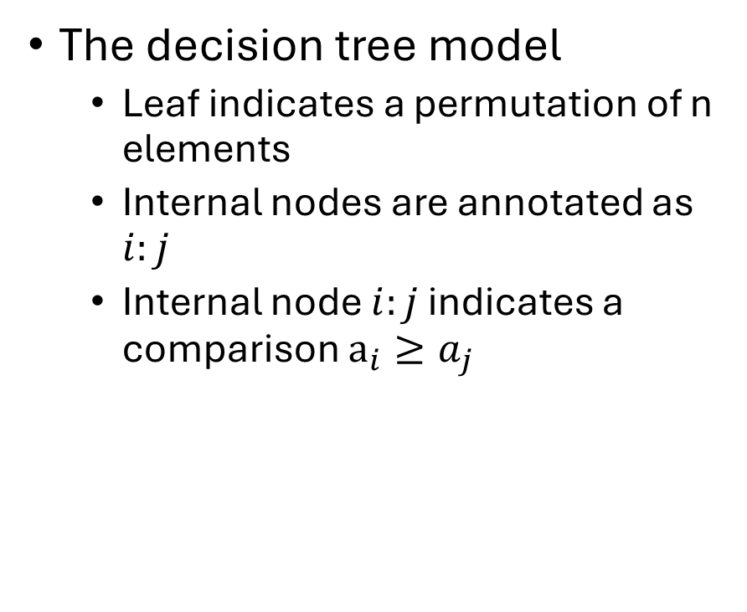
Lower Bounds for Sorting
The decision tree model
Leaf indicates a permutation of n elements
Internal nodes are annotated as $i:j$
Internal node $i:j$ indicates a comparison $a_{i}≥a_{j}$

Slide 6
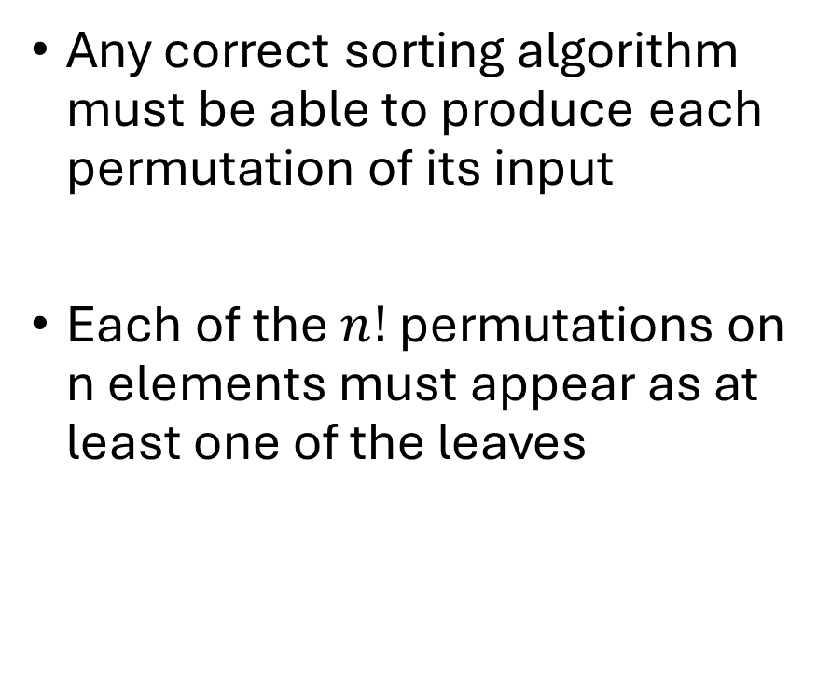
Lower Bounds for Sorting
Any correct sorting algorithm must be able to produce each permutation of its input
Each of the $n!$ permutations on n elements must appear as at least one of the leaves

Slide 7
Lower Bounds for Sorting
Worst-case comparisons
Longest simple path length from the root to any of its reachable leaves
Equals the height of the decision tree
Can we estimate a bound of the height of such decision trees?

Slide 8
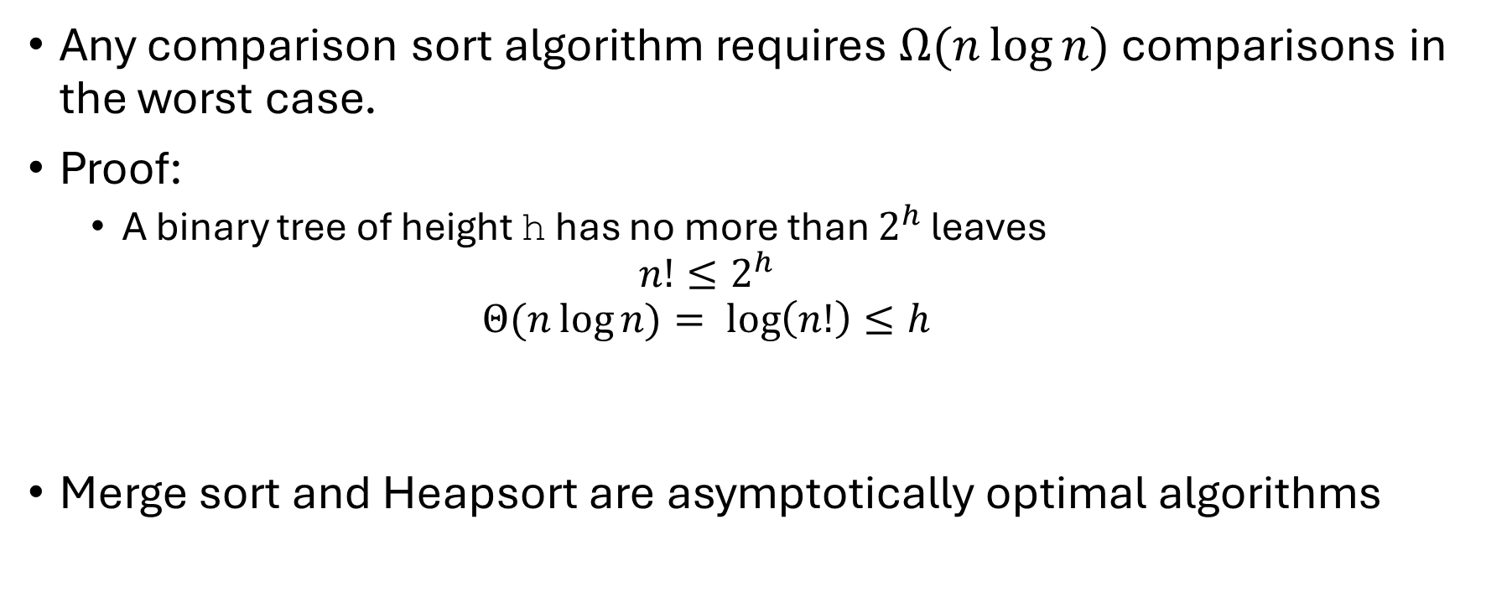
Lower Bounds for Sorting
Any comparison sort algorithm requires $Ω(n\log{n)}$comparisons in the worst case.
Proof:
A binary tree of height h has no more than $2^{h}$ leaves
$$n!≤2^{h}$$
$$Θ(n\log{n)}= log\left(n!\right)≤h$$
Merge sort and Heapsort are asymptotically optimal algorithms

Slide 9
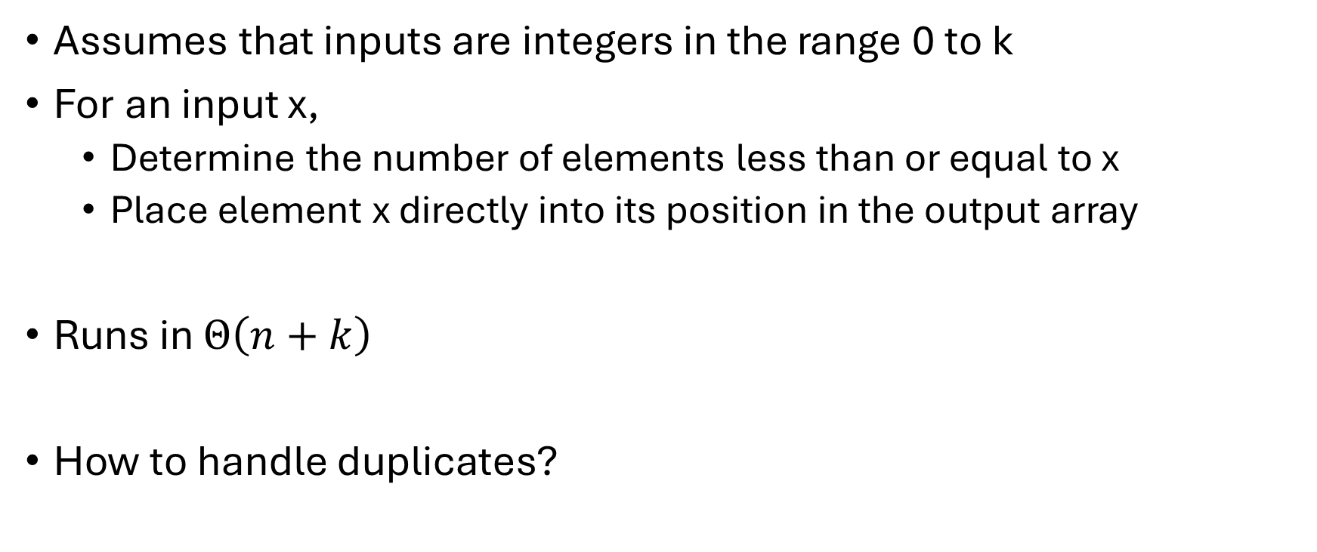
Counting Sort
Assumes that inputs are integers in the range 0 to k
For an input x,
Determine the number of elements less than or equal to x
Place element x directly into its position in the output array
Runs in $Θ\left(n+k\right)$
How to handle duplicates?

Slide 10
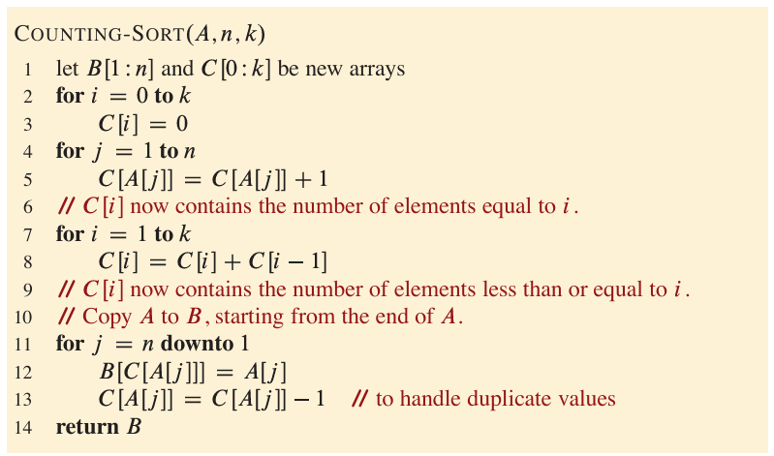
Counting Sort

Slide 11
Counting Sort
A
2 | 5 | 3 | 0 | 2 | 3 | 0 | 3
C
2 | 0 | 2 | 3 | 0 | 1

Slide 12
Counting Sort
A
2 | 5 | 3 | 0 | 2 | 3 | 0 | 3
C (old)
2 | 0 | 2 | 3 | 0 | 1
C
(current state)
2
2
4
7
7
8

Slide 13
Counting Sort
A
2 | 5 | 3 | 0 | 2 | 3 | 0 | 3
C
(current state)
2
2
4
7
7
8
B

Slide 14
Counting Sort
A
2 | 5 | 3 | 0 | 2 | 3 | 0 | 3
C
(current state)
2
2
4
7
7
8
B
 |  |  |  |  |  | 3

Slide 15
Counting Sort
A
2 | 5 | 3 | 0 | 2 | 3 | 0 | 3
C
(current state)
2
2
4
6
7
8
B
 |  |  |  |  |  | 3

Slide 16
Counting Sort
A
2 | 5 | 3 | 0 | 2 | 3 | 0 | 3
C
(current state)
2
2
4
6
7
8
B
 | 0 |  |  |  |  | 3

Slide 17
Counting Sort
A
2 | 5 | 3 | 0 | 2 | 3 | 0 | 3
C
(current state)
1
2
4
6
7
8
B
 | 0 |  |  |  |  | 3

Slide 18
Counting Sort
A
2 | 5 | 3 | 0 | 2 | 3 | 0 | 3
C
(current state)
1
2
4
6
7
8
B
 | 0 |  |  |  | 3 | 3

Slide 19
Counting Sort
A
2 | 5 | 3 | 0 | 2 | 3 | 0 | 3
C
(current state)
0
2
2
4
7
7
B
0 | 0 | 2 | 2 | 3 | 3 | 3 | 5

Slide 20
Counting Sort
Counting sort is stable
Elements with the same value appear in the output array in the same order as they do in the input array.

Slide 21
Radix Sort
We can sort the elements
By most significant (leftmost) digit
Then sort the resulting bins recursively
Finally combine the bins in order.
Generates many intermediate bins to track

Slide 22
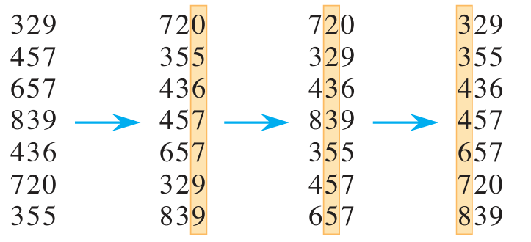
Radix Sort
Let’s start by the least significant bit
For example,

Slide 23
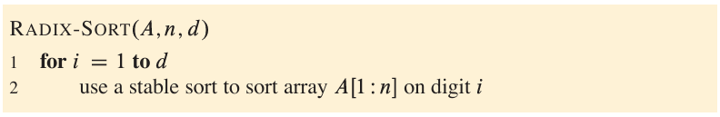

Radix Sort
Radix-sort sorts n d-digit number in $O(d\left(n+k\right))$

Slide 24
Bucket Sort
Assumes that the input is uniformly distributed in a range
Divides the range into n equal-sized subintervals, or buckets
Distributes the inputs into the buckets
The inputs are uniformly distributed
Expected number of input per bucket is low
Sort the numbers in each bucket
Go through the buckets in order, listing the elements in each

Slide 25
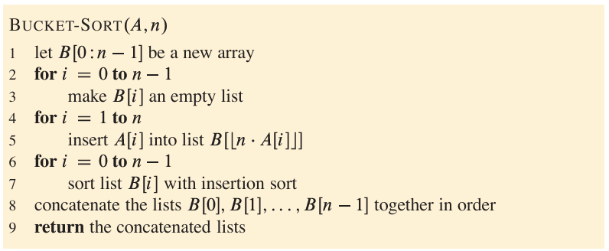
Bucket Sort

Slide 26
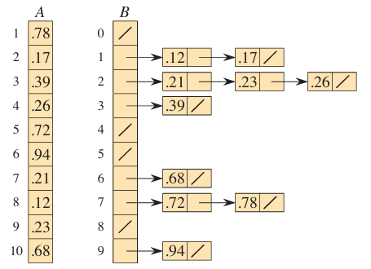

Bucket Sort
Runs in $O(n)$

Slide 27
Reference
Sorting in Linear Time
CLRS 4th Ed. Chapter 8

